Slide 1

Selfie Pasanga (Fetch in a touch)
Rengaraj Selvaraj, Vetrivel Kumar

Slide 2
Are You ???
Are You Bored of Legacy Word Search ?
Are you looking for a advanced way of Searching?
If yes, you are wise ☺

Slide 3
Selfie Pasanga
Here You Go………………
Take a Snap of anything for one time and say what it is
. Your transactions will be shown up based on the image’s category

Slide 4

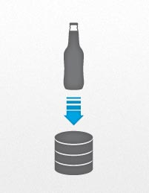
HOW IT WORKS?
Take a Snap And Upload
Image Gets Uploaded to DB

Slide 5

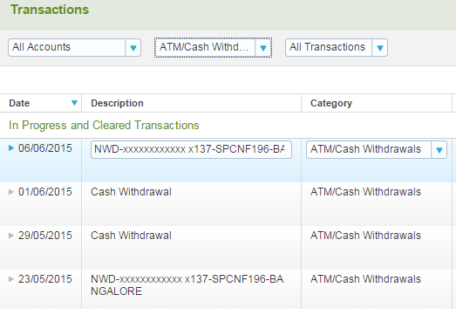
How IT WORKS
Image’s Category Recognized
Hurrah !!! Got the categorized transactions

Slide 6
Thank You !!!!!!!!!!!!
TOUCH TO FETCH !!!

